Slide 1


Project
Defense
Voice-based transport enquiry system

Slide 2


Main idea
In order to help blind people, this project was
created to help them with navigation through the city.

Slide 3

1st step
Identify main idea of my project an future uses of it.
2nd step
Identify entities of tables
3rd step
Create 10 tables and insert values

Slide 4


What is Voice Based Transport Enquiry System?
"Voice Input Transport Enquiry System"
is a framework that works dependent on the voice input given by the client who
expects to think about transportation offices accessible from a specific
terminal.

Slide 5
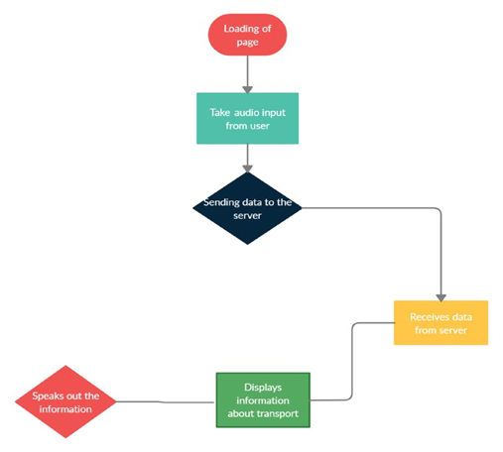
How it works?

Slide 6
Tables that were created
1) Bus-this table includes values such as bus_id, bus_name, bus_type, bus_number, totalseats and aviableseats.
2) BusType-this table includes values such as bustype_id, bus_name and bus_id
3) Users-this table includes values such as user_id, user_name, password and repassword.
4) Location-this table includes values such as loc_id, loc_name, user_id
5) Timetable-this table includes values such as time_id, firstloc_name,lastloc_name,day
6) Needed time-this table includes values such as time_id, departure_t, arrival_t, day, user_id, user_name
7)Bus_stops-this table includes values such as st_id, stop_num, bus_name, bus_id
8)Fare-this table includes values such as fare_id, fare, bus_type, bustype_id
9)City- this table includes values such as city_id, city_name, bus_id, bus_type
10)Distance-this table includes values such as dist_id, bus_name, loc_name, dist

Slide 7
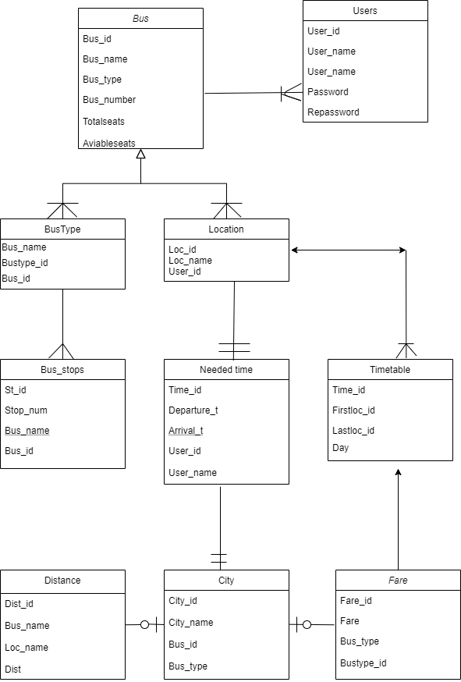


ERD

Slide 8

Conclusion
Voice Based Public Transport Enquiry System is a needy practical system that is useful in not only providing the bus details, it helps in travel planning and saves enormous timing of the user, which otherwise would have spent in waiting at the bus stations. Unlike with the SMS based systems, in which the user needs to send sms in predefined formats, this system is very simple to use and more accurate.

Slide 9
Thank for your atterntion

